Slide 1


Salary Analytics™
Integrated salary reporting system
raporty-placowe.pl
Copyright by ProXmedia 2011

Slide 2
Salary Analytics™ usage suggested forms of use
Recruitment
Labour market monitoring
Consulting Services - HR consultancy
Company presentations: board meetings, team meetings etc.
Competitor analysis - operating in various sectors on the market
The following pages contain examples of the application’s screenshots
Copyright by ProXmedia 2011

Slide 3
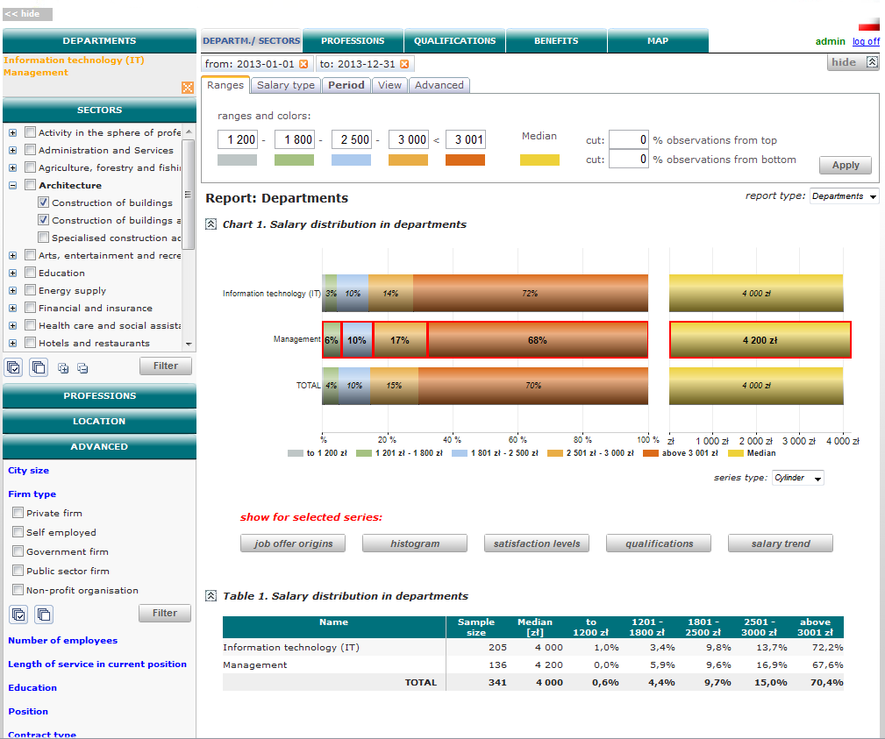
Report „Departments”
Shows a breakdown of salary ranges for various firm departments
Main features
The possibility to adjust the salary range thresholds
The possibility of limiting the sample from the bottom and top of the boundary
The possibility to customize the data for a specific period of time
The possibility to view additional information for each series such as decile relation, Gini index etc.
The possibility to observe salary trend, satisfaction levels, qualification occurrence - in all salary ranges
* Random data
Copyright by ProXmedia 2011

Slide 4
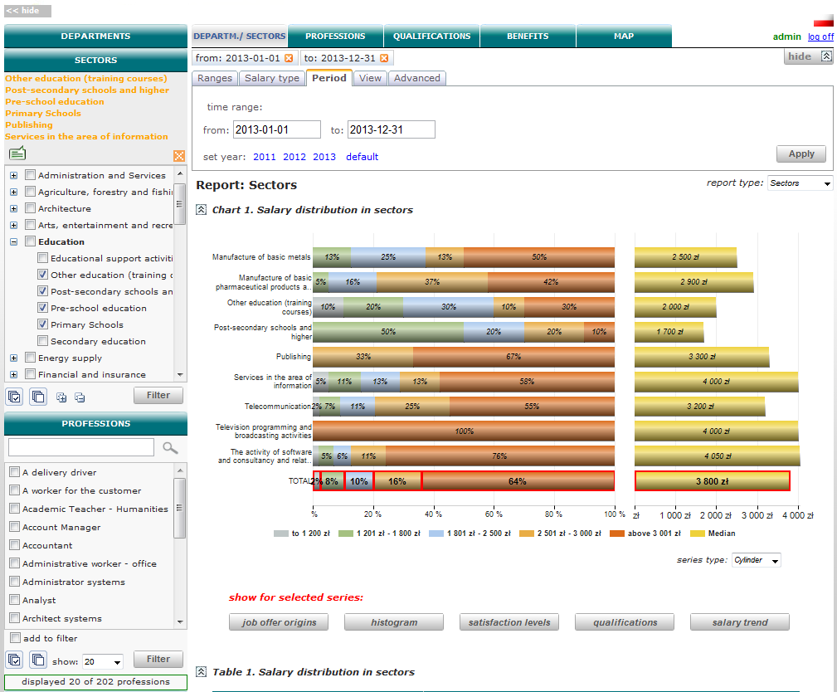
Report „Sectors”
Shows a breakdown of salary ranges for the sectors according to PKD
Main features
The possibility to adjust the salary range thresholds
The possibility of limiting the sample from the bottom and top of the boundary
The possibility to customize the data for a specific period of time
The possibility to view additional information for each series such as decile relation, Gini index etc.
The possibility to observe salary trend, satisfaction levels, qualification occurrence - in all salary ranges
* Random data
Copyright by ProXmedia 2011

Slide 5
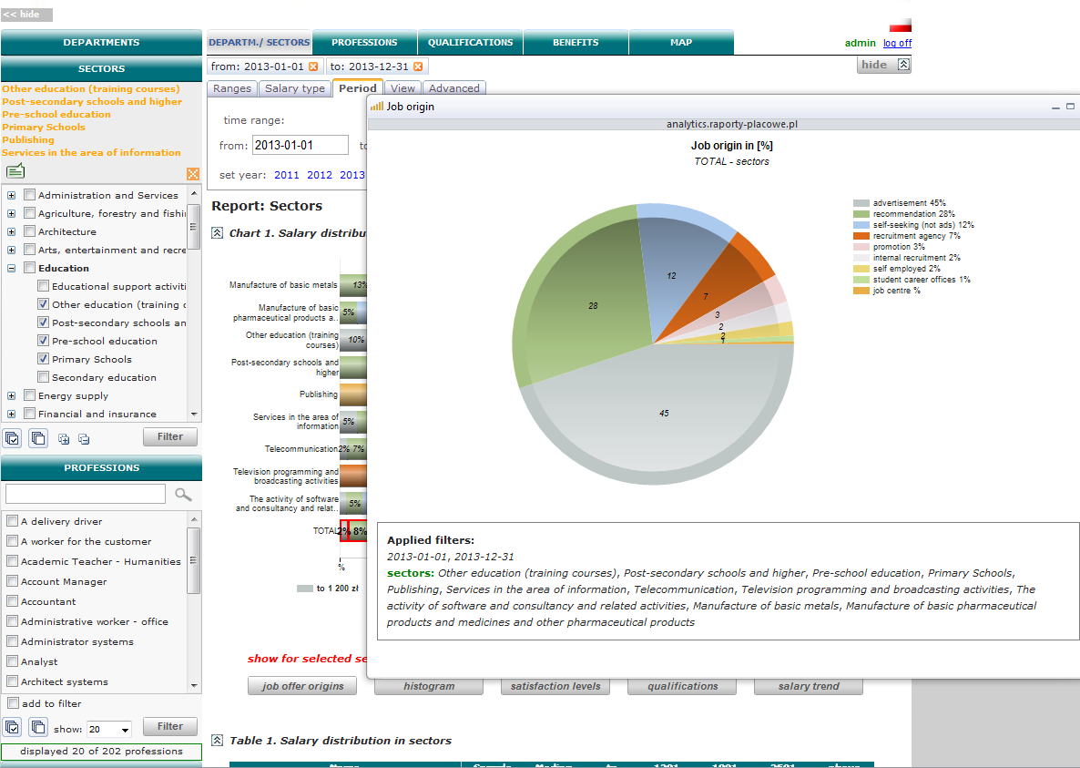
Job offer sources
Shows a breakdown of job origin sources as a percentage
Main features
The possibility of presenting data for departments, sectors, groups and individual professions
The possibility to filter by all available data ranges
The possibility of limiting the sample from the bottom and top of the boundary
The possibility to customize the data for a specific period of time
The possibility of presenting multiple data series at once
* Random data
Copyright by ProXmedia 2011

Slide 6
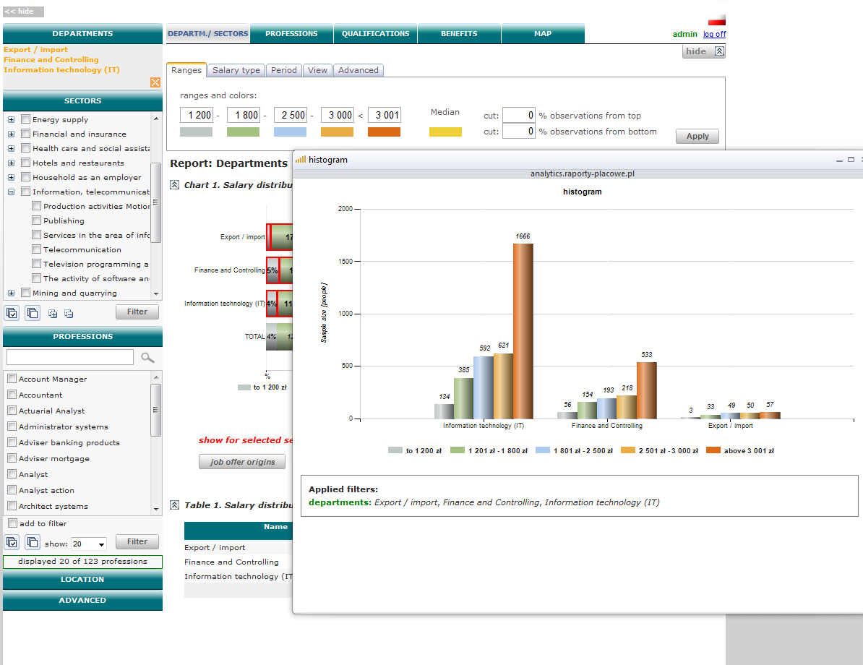
Histogram
Shows a breakdown of the number of people in each salary ranges
Main features
The possibility to adjust the salary range thresholds
The possibility of limiting the sample from the bottom and top of the boundary
The possibility to customize the data for a specific period of time
The possibility of presenting multiple data series at the same time with the division into salary ranges
* Random data
Copyright by ProXmedia 2011

Slide 7
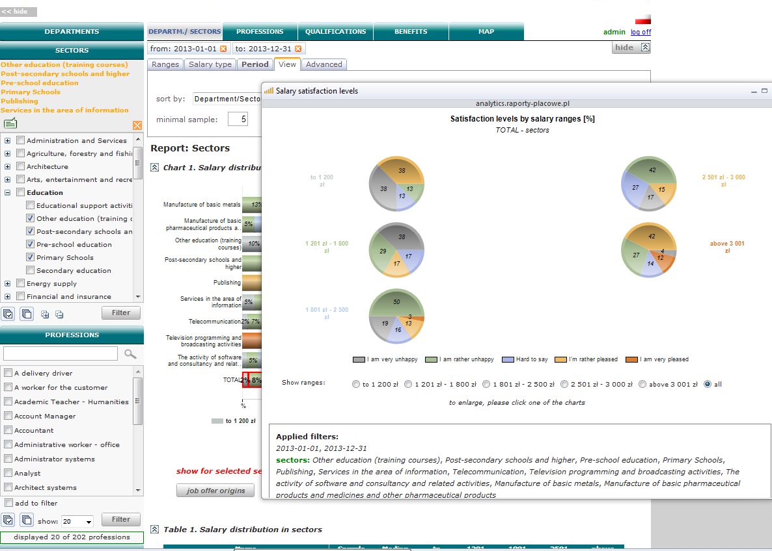
Satisfaction levels
Shows the satisfaction levels in salary ranges
Main features
The possibility to adjust the salary range thresholds
The possibility of limiting the sample from the bottom and top of the boundary
The possibility to customize the data for a specific period of time
The possibility to analyze a single salary range
* Random data
Copyright by ProXmedia 2011

Slide 8
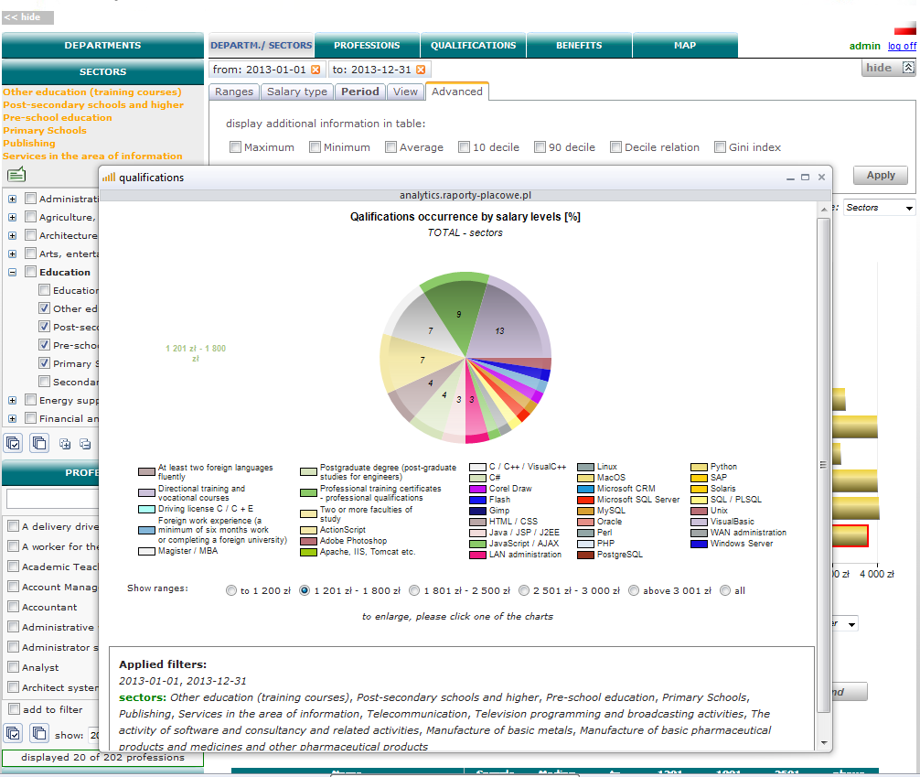
Professional Qualifications
Shows qualification’s occurrence in salary ranges
Main features
The possibility to adjust the salary range thresholds
The possibility of limiting the sample from the bottom and top of the boundary
The possibility to customize the data for a specific period of time
The possibility to analyze professional qualifications for various sectors of the economy
* Random data
Copyright by ProXmedia 2011

Slide 9
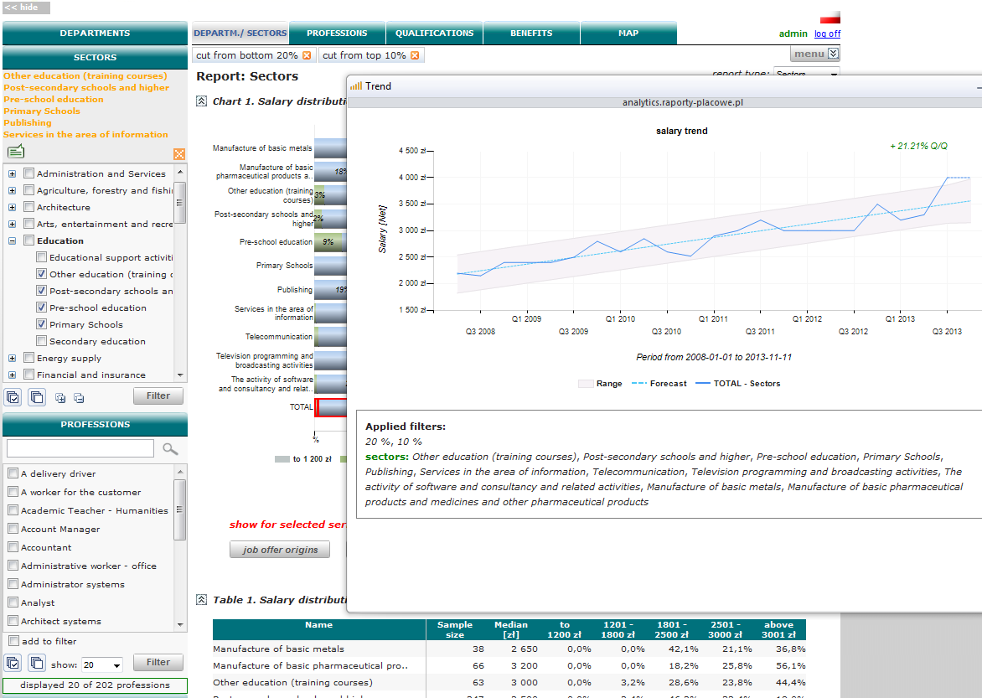
Salary trend
Presents the change in average earnings on a quarterly basis
Main features
The possibility to adjust the salary range thresholds
The possibility to customize the data for a specific period of time
The possibility to analyze the salary trend from previous quarters
The possibility to analyze data from the current quarter (or even half of the quarter)
* Random data
Copyright by ProXmedia 2011

Slide 10
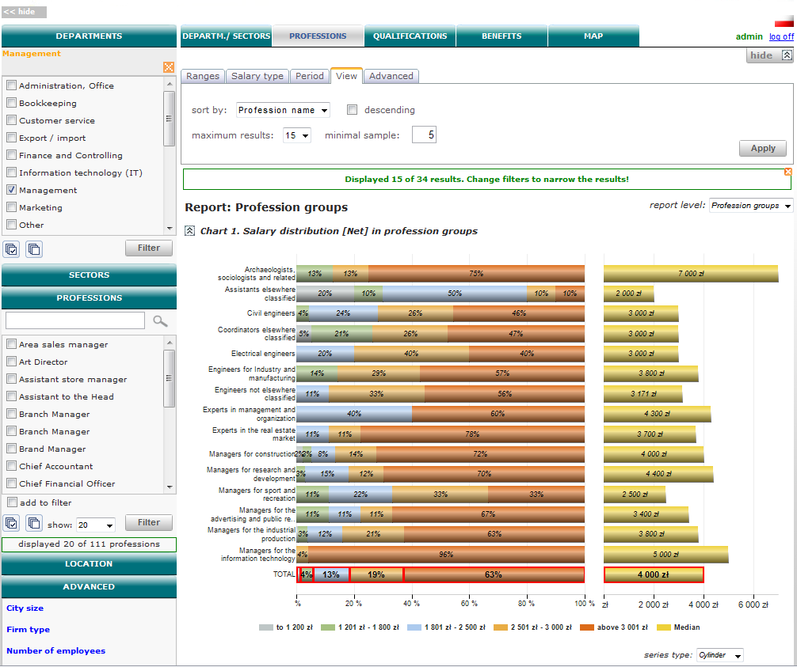
Report „Professions”
Shows a breakdown of profession groups in salary ranges
Main features
The possibility to adjust the salary range thresholds
The possibility of limiting the sample from the bottom and top of the boundary
The possibility to customize the data for a specific period of time
The possibility to view additional information for each series such as decile relation, Gini index etc.
The possibility to observe salary trend, satisfaction levels, qualification occurrence - in all salary ranges
* Random data
Copyright by ProXmedia 2011

Slide 11
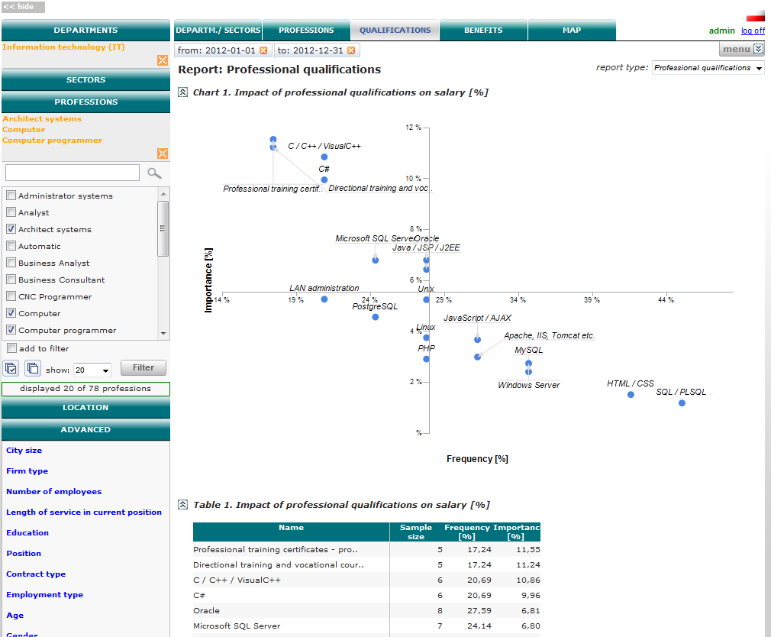
Report „Professional Qualifications”
Shows the impact of professional qualifications on wages
Main features
The possibility to customize the data for a specific period of time which allows the observation of changes in the professional qualifications
The possibility of limiting the sample from the bottom and top of the boundary
The possibility to view additional information for each series such as median and salary average
The possibility to observe the frequency of specific professional qualifications in a given period of time and location
* Random data
Copyright by ProXmedia 2011

Slide 12
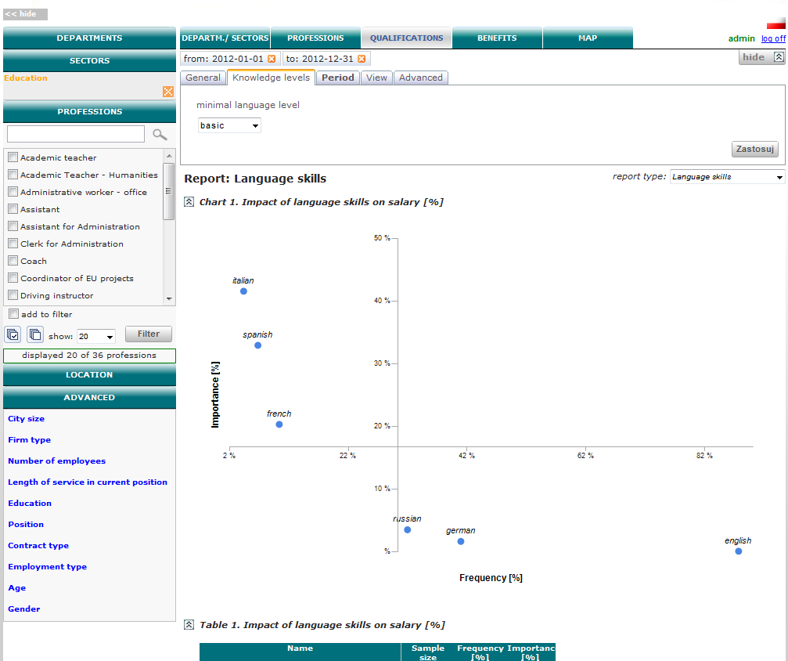
Report „Language skills”
Shows the impact of language skills on wages
Main features
The possibility to customize the data for a specific period of time which allows the observation of changes in the language skills over time
The possibility to view additional information for each series such as median and average salary
The possibility to observe the frequency of specific language skills in a given period of time and location
The possibility to adjust the minimum language skills level
* Random data
Copyright by ProXmedia 2011

Slide 13
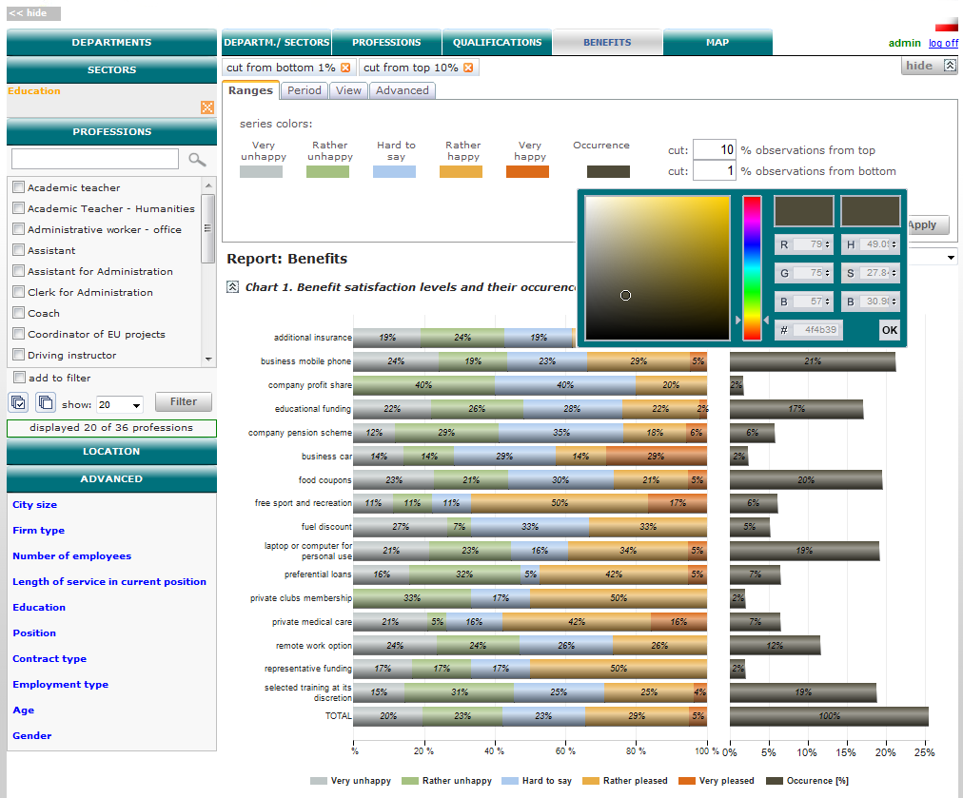
Report „Benefits”
Presents the distribution of satisfaction with received benefits
Main features
The possibility to adjust the minimum sample size
The possibility of limiting the sample from the bottom and top of the boundary
The possibility to customize the data for a specific period of time
The possibility to view additional information for each series such as median and average salary
The possibility to sort the data by levels of satisfaction and occurrence
* Random data
Copyright by ProXmedia 2011

Slide 14
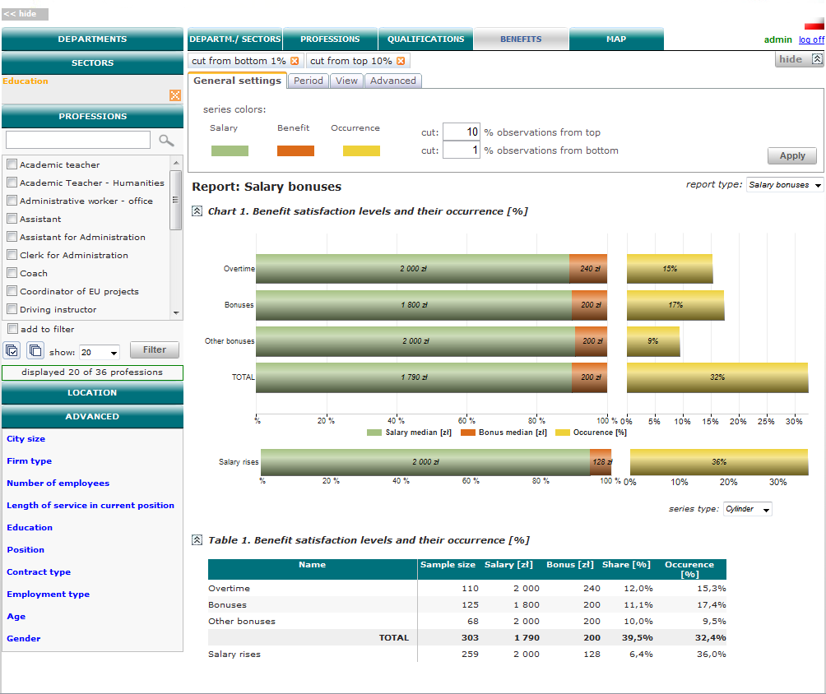
Report „Salary bonuses”
Presents the share of the salary increases in wages and their occurrence [%]
Main features
The possibility to adjust the minimum sample size
The possibility of limiting the sample from the bottom and top of the boundary
The possibility to customize the data for a specific period of time
The possibility to view additional information for each series such as median and average salary
* Random data
Copyright by ProXmedia 2011

Slide 15
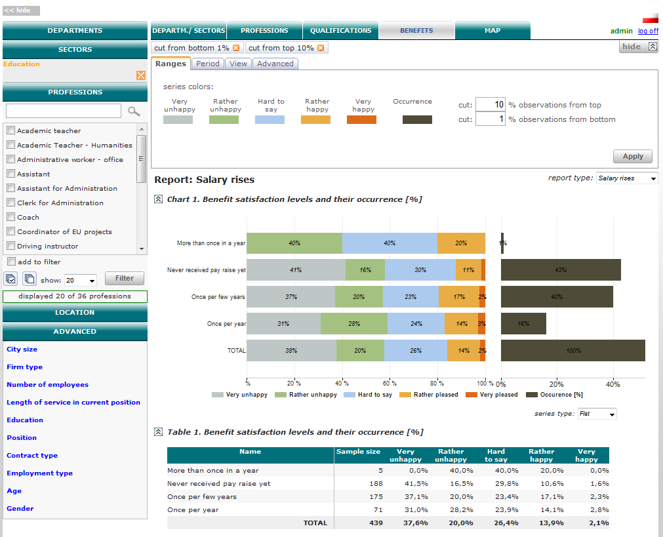
Report „Salary rises”
Shows the levels of satisfaction with the received increases and their occurrence [%]
Main features
The possibility of limiting the sample from the bottom and top of the boundary
The possibility to customize the data for a specific period of time
The possibility to view additional information for each series such as median and average salary
The possibility to analyze pay increases in various sectors of the economy and different position levels
* Random data
Copyright by ProXmedia 2011

Slide 16
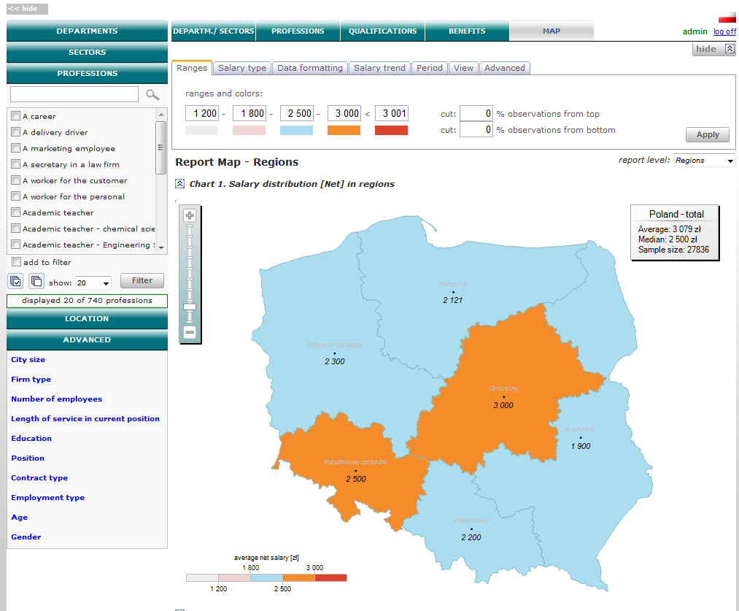
Report „Map - regions”
Presents the distribution of wages by region
Main features
The possibility to adjust the salary range thresholds
The possibility of limiting the sample from the bottom and top of the boundary
The possibility to customize the data for a specific period of time
The possibility to view additional information for each series such as decile relation, Gini index etc.
The possibility to adjust the format of the map that is based on the median, average wages, according to working hours or place of residence
* Random data
Copyright by ProXmedia 2011

Slide 17
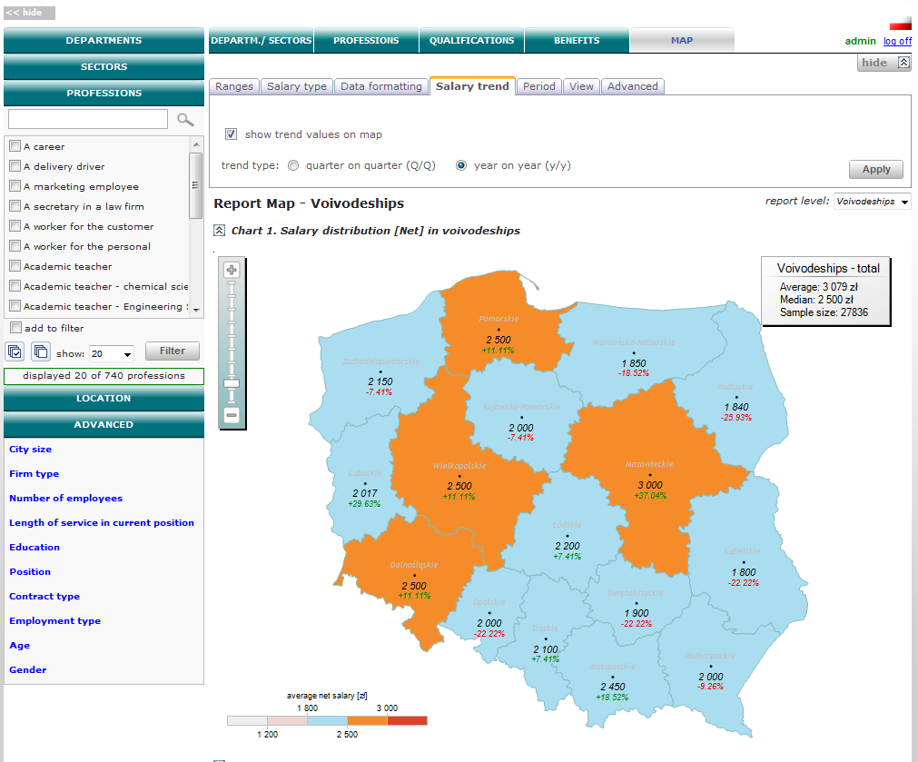
Report „Map - voivodeships ”
Shows a breakdown of salaries broken down by province
Main features
The possibility to analyze salary trend (year-on-year and quarter-on-quarter)
The possibility of limiting the sample from the bottom and top of the boundary
The possibility to customize the data for a specific period of time
The possibility to view additional information for each series such as decile relation, Gini index etc.
The possibility to adjust the format of the map that is based on the median, average wages, according to working hours or place of residence
* Random data
Copyright by ProXmedia 2011

Slide 18
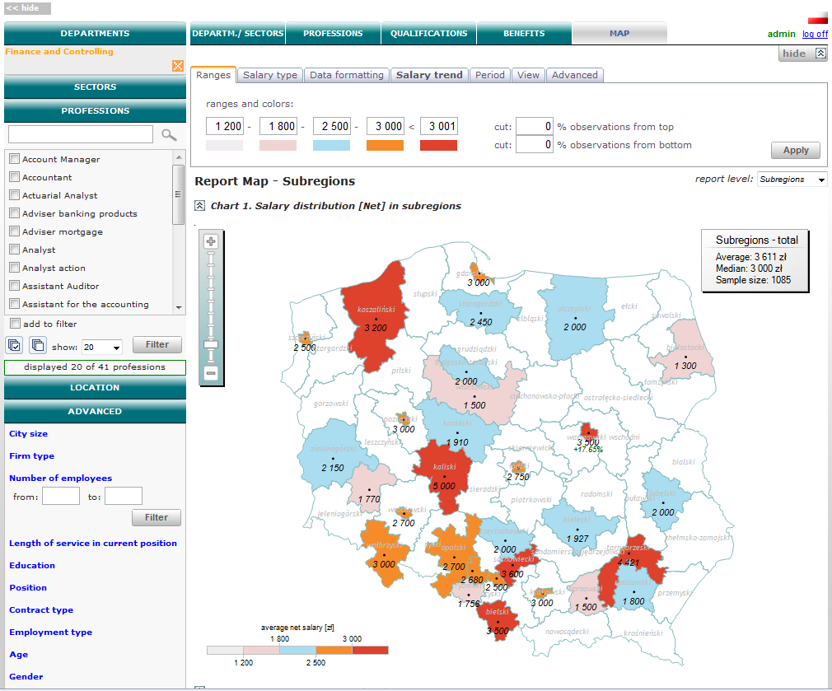
Report „Map - sub regions”
Shows a breakdown of salaries broken down into sub regions
Main features
The possibility to adjust the salary range thresholds
The possibility of limiting the sample from the bottom and top of the boundary
The possibility to customize the data for a specific period of time
The possibility to view additional information for each series such as decile relation, Gini index etc.
The possibility to adjust the format of the map that is based on the median, average wages, according to working hours or place of residence
* Random data
Copyright by ProXmedia 2011

Slide 19
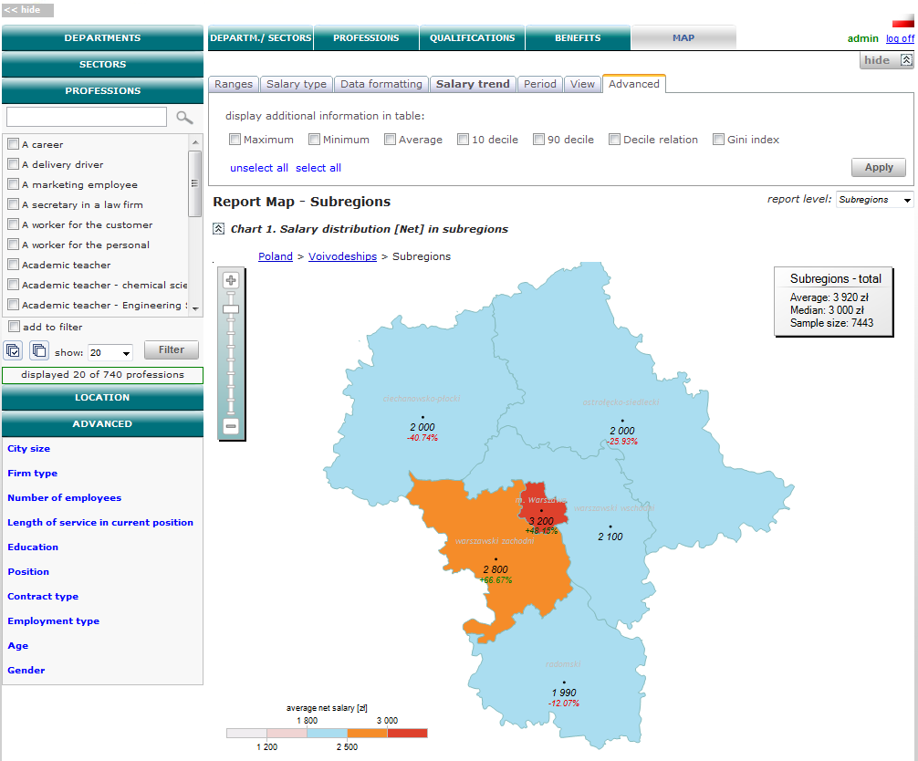
Report „Map – drill down”
Presents the distribution of wages in sub location ("drill down" function)
Main features
The possibility to adjust the salary range thresholds
The possibility of limiting the sample from the bottom and top of the boundary
The possibility to customize the data for a specific period of time
The possibility to view additional information for each series such as decile relation, Gini index etc.
The possibility to adjust the format of the map that is based on the median, average wages, according to working hours or place of residence
* Random data
Copyright by ProXmedia 2011

Slide 20
Additional information
Source of data:
Survey data are collected from online users wishing to compare their current salary to other users working in the same sector and holding similar position.
Users are not getting any money for completing the surveys, the only incentive is the desire to compare their data to the others. Every person can only fill in questionnaire once per year.
The more precise user fills in the data, the more detailed is the report he receives.
All questionnaires are manually verified.
The frequency of data collection :
New user’s data are collected every day, additionally every year we conduct the annual salary survey for the existing users allowing them to compare their changes with similar users.
Please contact us at
biuro@raporty-placowe.pl
Copyright by ProXmedia 2011

